Slide 1
PUBP309 · FLAME UNIVERSITY
Education Policy
Week 1 — Introduction & policies
Undergraduate · 3 credits · 2026
SHIVAKUMAR JOLAD
Notes:
Welcome to PUBP309, Education Policy. Week 1: introduction, course logistics and the framing question — what do we mean by education?

Slide 2
PART ONE
Course info & policies
What the course is and how it runs.
Notes:
First, the housekeeping: what the course is, how it runs, and what is expected of you.

Slide 3
THE BASICS
Course at a glance
COURSE CODE
CREDITS
PROGRAM
PUBP309
3
Undergraduate
A one-semester introduction to education policy in India.
Notes:
Three numbers to anchor on: course code PUBP309, three credits, offered at the undergraduate level.

Slide 4
PART TWO
Understanding education
From the learner outward — reading the system from micro to macro.
Notes:
Before policy, a foundation: what is education, and what shapes whether learning happens? We'll read the system from the learner outward.

Slide 5
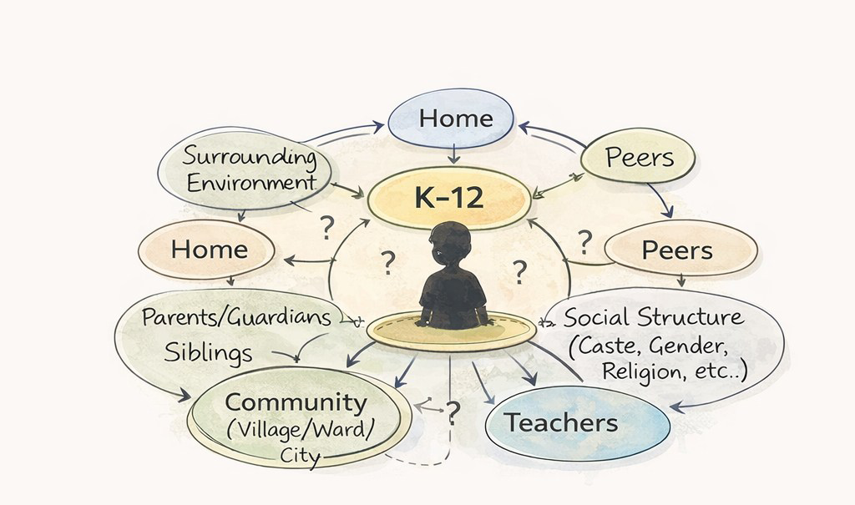
DETERMINANTS OF LEARNING
Who shapes a school learner?
A K–12 child sits inside widening circles — home and siblings, peers, teachers, community, and the social structure of caste, gender and religion.
Proximate → distant determinants
Notes:
Put a K-12 child at the centre. Home, peers, teachers, community and the surrounding social structure all act on whether and how they learn.

Slide 6
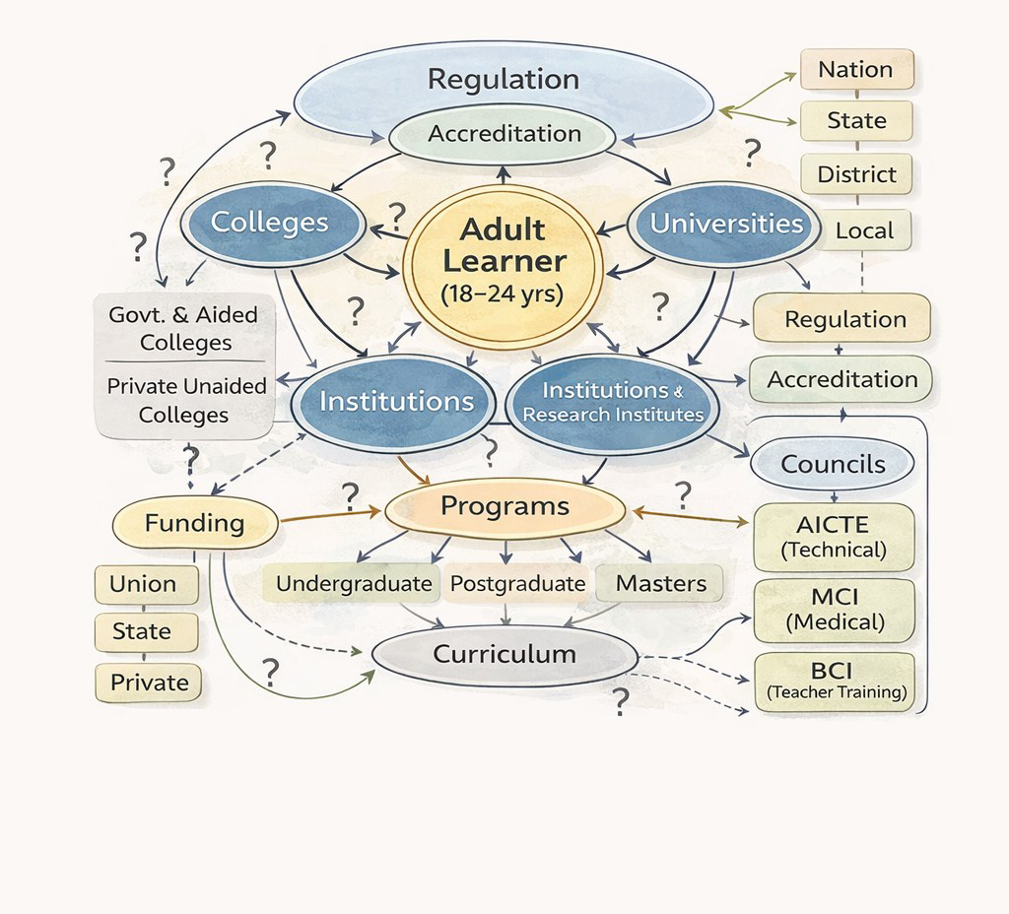
DETERMINANTS OF LEARNING
Who shapes an adult learner?
In higher education the circles change — colleges and universities, programs and curricula, funding from union, state and private sources, all under regulation and accreditation.
Learner, 18–24 years
Notes:
The same logic for higher education: an adult learner of 18-24 surrounded by colleges, universities, institutions, programs, regulation, accreditation and funding.

Slide 7
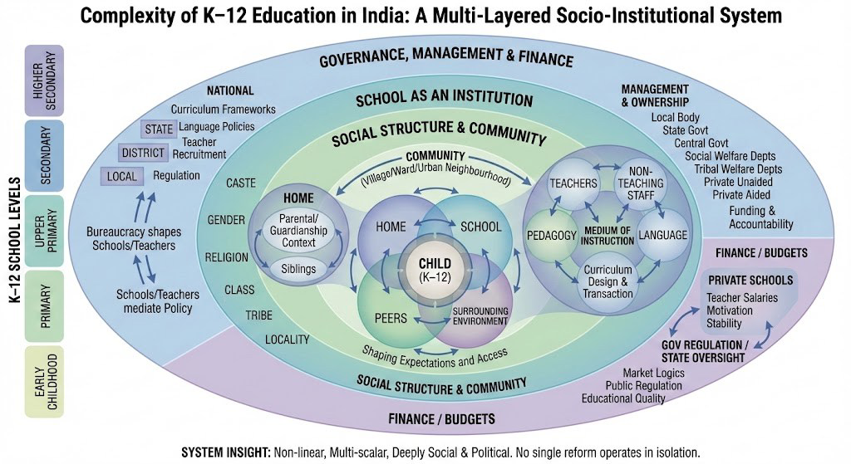
A MULTI-LAYERED SYSTEM
The complexity of school education
Non-linear, multi-scalar, deeply social & political — no single reform works alone.
Notes:
Zoom out and the school system is a multi-layered socio-institutional whole: governance, finance, social structure and community all nest together. No single reform operates in isolation.

Slide 8
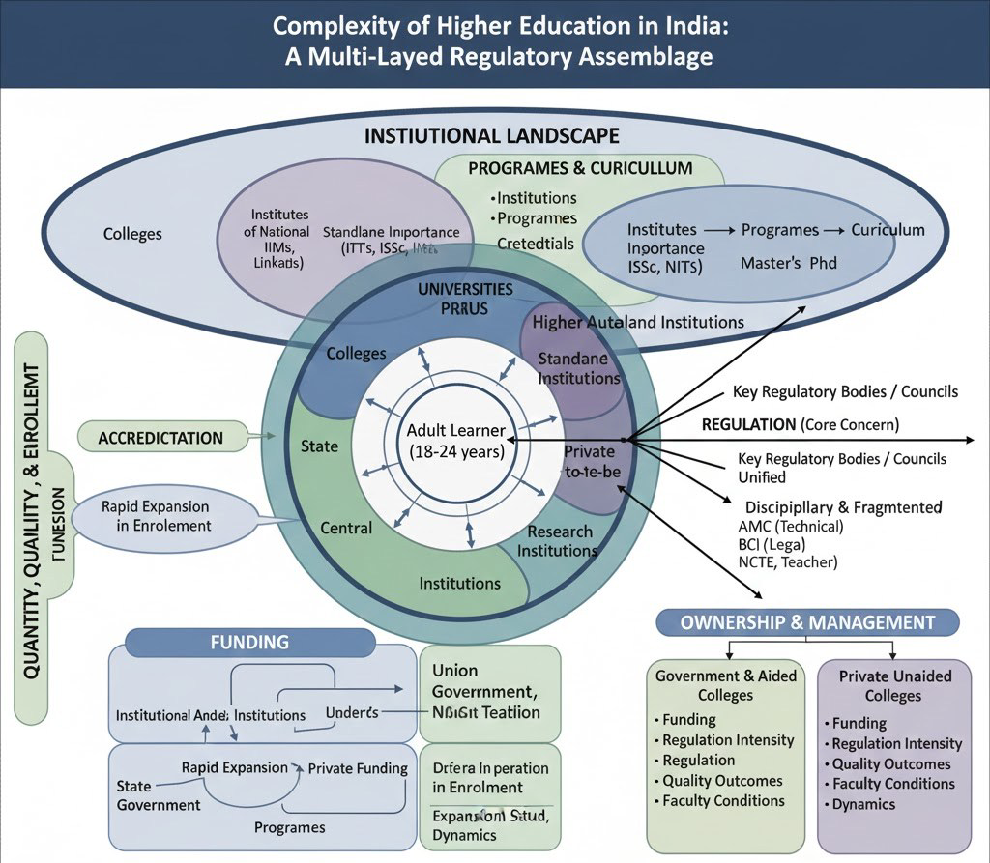
A REGULATORY ASSEMBLAGE
The complexity of higher education
Quantity, quality and enrolment pull against a fragmented field of regulators, councils, funders and owners — public, aided and private.
Regulation is the core concern.
Notes:
Higher education is its own regulatory assemblage — institutions, programs, funding and a thicket of regulatory bodies and councils around quality, access and enrolment.

Slide 9
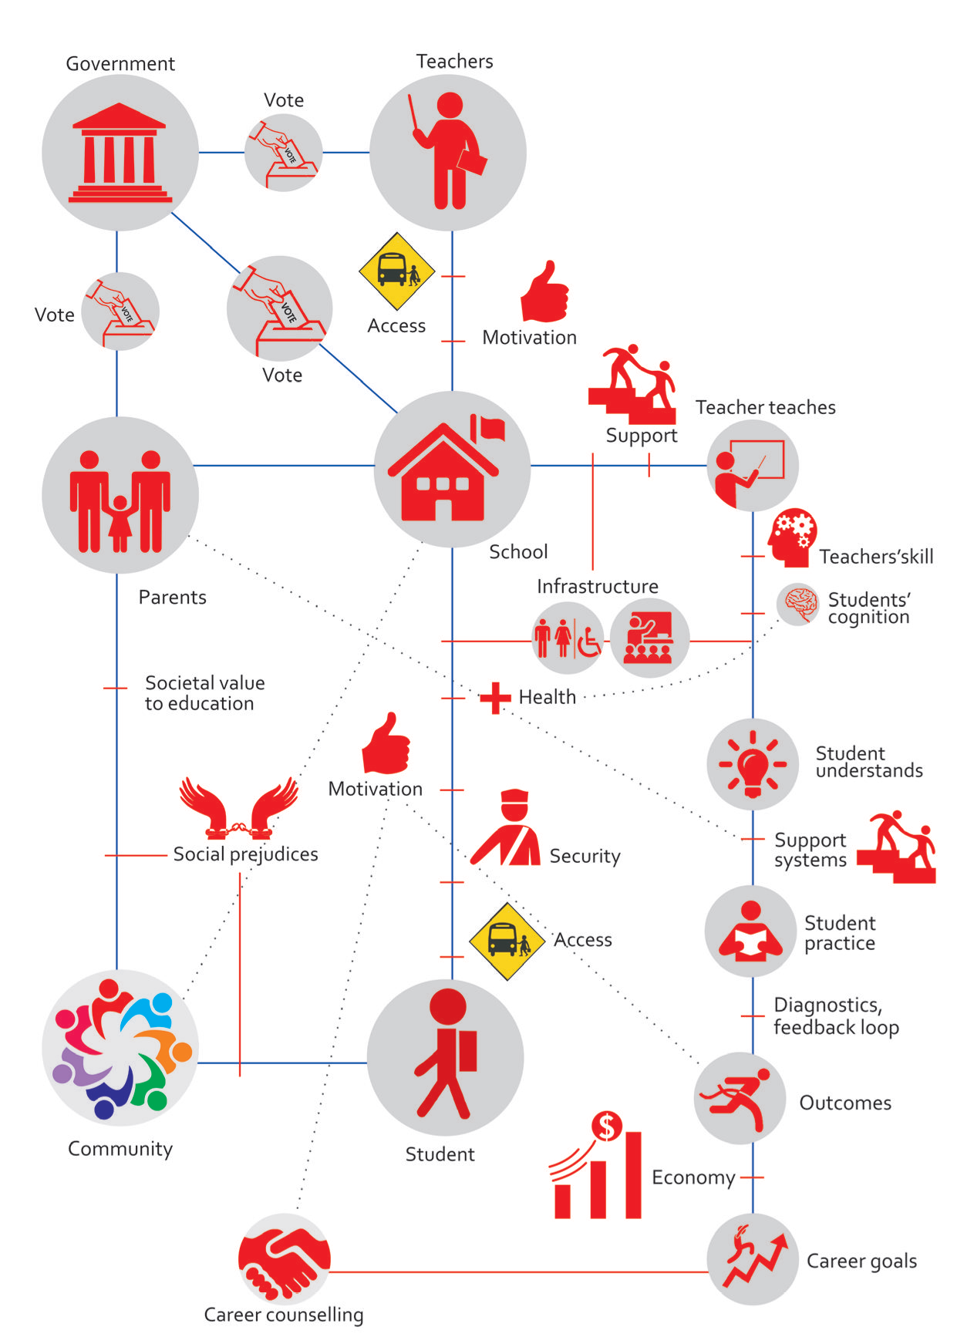
POLICY → OUTCOME
The black box of reform
Between a policy and a result sits a long chain — government, parents, community, school, teachers and students, tied together by access, motivation, support and feedback. Reform succeeds or fails inside this box.
“UnpackED” — Karthik Dinne
Notes:
What actually happens between a policy and a learning outcome? The reform black box — government, parents, community, school, teachers and students, all linked by access, motivation and feedback.

Slide 10
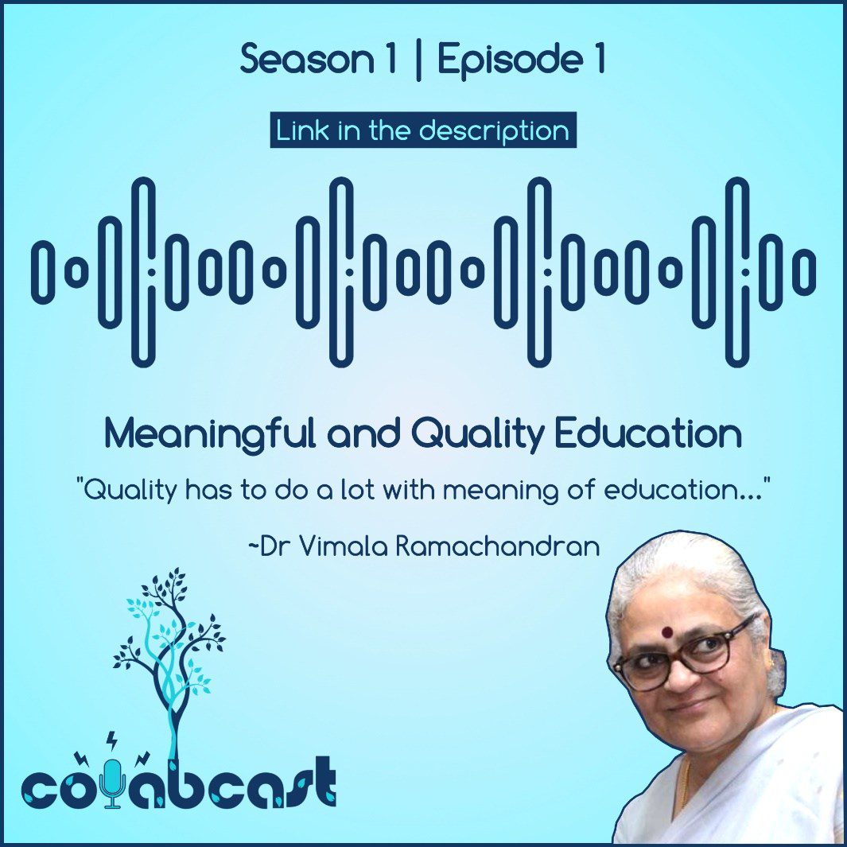
LISTEN & DISCUSS
What does education mean?
“Quality has to do a lot with the meaning of education.”
DR. VIMALA RAMACHANDRAN
ColabCast · Season 1, Episode 1 — play 3:00–7:30
open.spotify.com/episode/2BxsryLSsSkIO9jDYPFAFQ
Notes:
We open the substantive discussion with a question: what does education mean? Listen to ColabCast S1E1, minutes 3:00 to 7:30 — Dr Vimala Ramachandran on meaningful and quality education.

Slide 11
PART THREE
Scope, topics & readings
Where the semester goes.
Notes:
Now the scope: what the course aims to do, the topics we cover across four parts, the questions we examine, and what to read.

Slide 12
OBJECTIVES OF THE COURSE
What you will be able to do
01
Trace how India's education system and policies evolved across colonial and post-colonial India.
02
Critically examine challenges in elementary and secondary education — and the policy instruments used to address them.
03
Understand the growth and challenges of higher education in India.
04
Evaluate an education-policy proposal or instrument in its appropriate context.
Notes:
Four objectives — historical understanding, critical examination of school-level challenges, the higher-education story, and the skill of evaluating a policy in context.

Slide 13
PART 1
20 HOURS
Indian Education System and History
1.1 School system in India
10 HRS
1.3 Higher education system
8 HRS
Current structure & comparative schooling — India, China, USA, Japan
History: indigenous, colonial & missionary schools; thinkers of modern education
Modern India: UEE, Right to Education, Kothari Commission & NPE
Growth of private schools & school management
Current structure & comparative analysis across the world
Colonial roots: Wood's Dispatch, the 1858 universities, University Acts
UGC and the expansion of colleges & universities
Private universities & institutions of national importance
1.2 History of Schooling in India
Indigenous Education and Schools
Education in Colonial India: Missionary Schools, British Schools, and Grant in Aid Schools; Thinkers of Modern Education
Major Education Policies in Colonial India; Schools and School Management in Colonial India
National Education System
Preceded by a 2-hour introduction — layers, levels and determinants of learning.
Notes:
Part 1, twenty hours, is the education system itself: the school system over ten hours and higher education over eight, plus a two-hour framing introduction.

Slide 14
PART 2
10 HOURS
Education bureaucracy & finance
Education in the Constitution
School education governance
Higher education governance
Constituent Assembly debates
Union, State & Concurrent lists
RTE, child labour, language & minority institutions
Bureaucracy at national, state & local level
Decentralisation & RTE
Teacher education & state capacity
UGC, regulatory bodies & councils
State & private university acts
Commissions & NEP in higher education
Notes:
Part 2, ten hours, is bureaucracy and finance: where education sits in the Constitution, and how school and higher education are governed.

Slide 15
PART 3
9 HRS
PART 4
4 HRS
Curriculum, pedagogy & learning
Interventions & reforms
Language & medium of instruction — the mother-tongue debate
The crisis of learning — foundational literacy & numeracy
Social barriers — caste, class, gender & disability
Access & retention — midday meals, cycles, cash transfers
Learning — Teaching at the Right Level, activity-based & adaptive learning
Structure & choice — school complexes, vouchers, RTE 12(1)(c)
Notes:
Parts 3 and 4 turn to the classroom and to reform: curriculum, pedagogy and the learning crisis; then the interventions that try to fix access, learning and governance.

Slide 16
THE THROUGH-LINE
Policy questions we will examine
Access & equity in elementary education
Education outcomes & the learning-level crisis
Gender & education
Public spending on education
Universalization of elementary education
Privatization of education
Higher education — expansion, access, quality & regulation
…read comparatively, evaluated as proposals.
Notes:
These are the policy questions the course keeps returning to — access, equity, gender, learning outcomes, spending, privatization and the higher-education frontier — read comparatively and evaluated as proposals.

Slide 17
CORE READINGS & RESOURCES
What to read
Sarangapani, P. M., & Pappu, R. (Eds.). (2021). Handbook of Education Systems in South Asia (Selected chapters). Springer.
Naik, J. P., & Nurullah, S. (1974). Students’ History of Education in India, 1800–1973. Macmillan.
Ghosh, S. C. (2009). The History of Education in Modern India, 1757–2007. Orient BlackSwan.
Indian Education Commission (Kothari Commission report) (1964–1966). Education and National Development (Kothari Commission Report). Government of India.
Mangla, A. (2022). Making Bureaucracy Work: Norms, Education, and Public Service Delivery in Rural India. Cambridge University Press.
Government of India. (1986). National Policy on Education 1986. Ministry of Human Resource Development, Government of India.
Government of India. (1992). Programme of Action 1992 (to the National Policy on Education, 1986). Ministry of Human Resource Development, Government of India.
Government of India (2019), Draft National Education Policy (2019). Government of India.
Muralidharan, K. (2024). Accelerating India’s development: A state-led roadmap for effective governance. Penguin Random House India. ISBN 978-0670095940.
Ayyar, R.V. Vaidyanatha, History of Education Policymaking in India, 1947 2016 (Delhi, 2017; online edn, Oxford Academic, 19 Apr. 2018,
…… Reports, Research Articles, Policy briefs…
Plus NPE 1986, NEP drafts, and selected reports, research articles & policy briefs.
Notes:
Core readings. We'll lean on Sarangapani and Pappu's handbook, the histories by Naik and Nurullah and by Ghosh, the Kothari report, Mangla on bureaucracy and Muralidharan's roadmap — alongside reports, articles and policy briefs through the term.

Slide 18
CORE READINGS & RESOURCES
What to read
Indian Education Commission (1964-1966) Report
Kingdon, G. G. (2007). The progress of school education in India. Oxford Review of Economic Policy, 23(2), 168-195.
(selected chapters) Mondal, Arijit (2015), The Universalization of elementary education in India : A historical analysis.
(Articles on Education )Drèze, J. (2017). Sense and Solidarity: Jholawala Economics for Everyone. Permanent Black.
(Chapter 4) Banerjee, A. V., Banerjee, A., & Duflo, E. (2011). Poor economics: A radical rethinking of the way to fight global poverty. Public Affairs.
…… Reports, Research Articles, Policy briefs…
Plus NPE 1986, NEP drafts, and selected reports, research articles & policy briefs.
Notes:
Core readings. We'll lean on Sarangapani and Pappu's handbook, the histories by Naik and Nurullah and by Ghosh, the Kothari report, Mangla on bureaucracy and Muralidharan's roadmap — alongside reports, articles and policy briefs through the term.

